Slide 1


KRAKEN QGIS PLUGIN • USER MANUAL
Compass
Precision protractor overlay for measuring sector directions, cell coverage distance, and beamwidth angles dynamically within QGIS map canvas.
Dynamic Ring Dial
Batch Import
Layer Export
360° rotated degree ticks with scrollable canvas scaling.
Seamless Ctrl+V clipboard integration from Excel data.
Instant vector layer generation for GIS sector mapping.
Kraken © 2026 | akanipatra@gmail.com

Slide 2

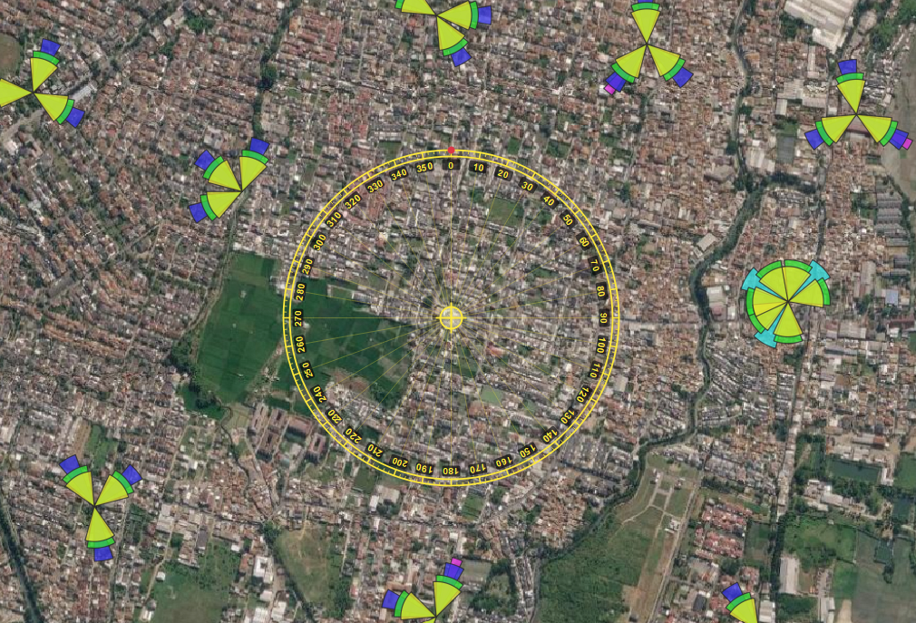


STEP 01 • CANVAS OVERLAY
Canvas Activation & Ring Dial Controls
Center Anchor Dragging
Left-click and hold the yellow center anchor to drag and reposition the compass across the map canvas.
Dynamic Wheel Resizing
Scroll mouse wheel while inside the compass zone to adjust dial radius from 80px up to 400px.
360° Rotated Scale
Renders major/minor tick marks per 2° with dark-backed rotated labels for high contrast over imagery.
Kraken © 2026 | akanipatra@gmail.com

Slide 3


STEP 02 • SINGLE BEARING CREATION
Adding & Editing Individual Wedges
2. Context Menu Adjustments
1. Dynamic Add Bearing
Right-click directly on any existing bearing wedge to trigger contextual modification tools tailored for fine-tuning sector attributes:
Right-click compass area and select Add Bearing. Move cursor to preview real-time direction, distance (m/km), and azimuth wedge preview before left-clicking to confirm.
•
Adjust Direction: Re-orient sector angle on canvas
•
Change Label: Rename sector display tag
•
Adjust Color & Beamwidth: Custom beam coverage (5°–360°)
Kraken © 2026 | akanipatra@gmail.com

Slide 4
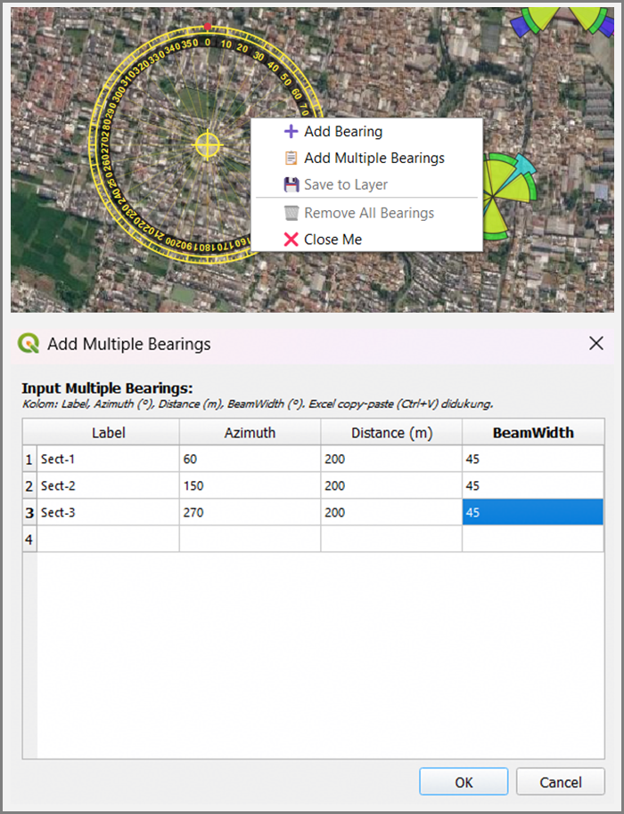

STEP 03 • BATCH INPUT
Multiple Bearings & Excel Clipboard Import
Add Multiple Bearings Dialog
Input complex multi-sector site configurations efficiently through structured tabular input.
Structured Table Columns
Supports Label, Azimuth (°), Distance (m), and Beamwidth (°).
Excel Clipboard Paste (Ctrl+V)
Copy cells directly from Excel and paste directly into the dialog table.
Auto-Expanding Rows
Automatically appends trailing rows upon populating values.
Kraken © 2026 | akanipatra@gmail.com

Slide 5
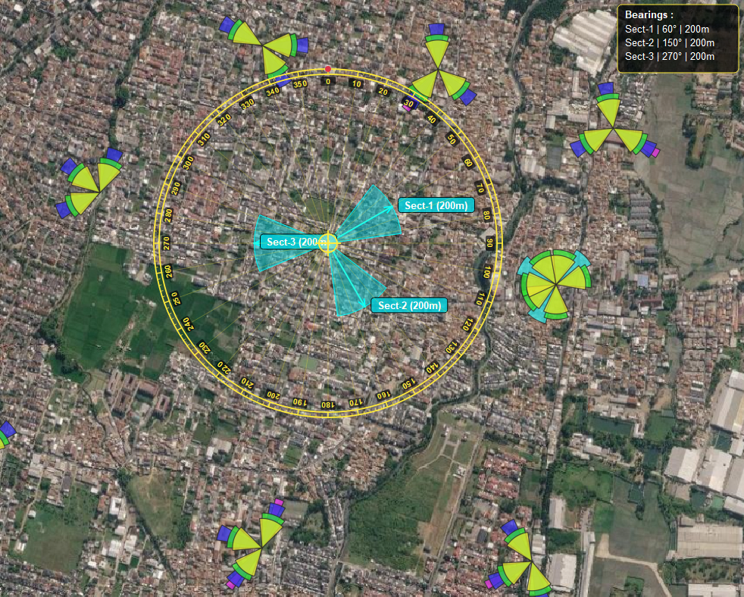
STEP 04 • SPATIAL DISPLAY
Sector Wedge Overlay & Legend Summary
Sector Visual Features
Dynamic Sector Wedges
Renders true geodesic arcs with active cyan stroke highlights and customizable alpha transparency.
Distance & Label Badges
Displays formatted text callouts (e.g., Sect-1 (200m)) pinned to sector tips.
Top-Right Legend Box
Real-time overlay panel summarizing active sectors, azimuth degrees, and calculated distances.
Kraken © 2026 | akanipatra@gmail.com

Slide 6
STEP 05 • GIS INTEGRATION
Exporting Bearings to QGIS Polygon Layer
1. Save to Layer
2. Memory Attribute Table
3. Automatic Styling
Right-click compass dial and select Save to Layer. Converts active screen wedges into true spatial polygon features.
Generates memory vector layer (Bearing_n_Dir) populated with structured fields:
Applies single-symbol cyan fill styling (120 alpha) with 0.6 stroke outline, immediately ready for map export or SHP/TAB saving.
•
Label (String)
•
Azimuth (Double)
•
Distance_m (Double)
•
Beamwidth (Double)
TRIGGER ACTION
DATA MODEL
AUTO-STYLING
Kraken © 2026 | akanipatra@gmail.com

